Slide 1
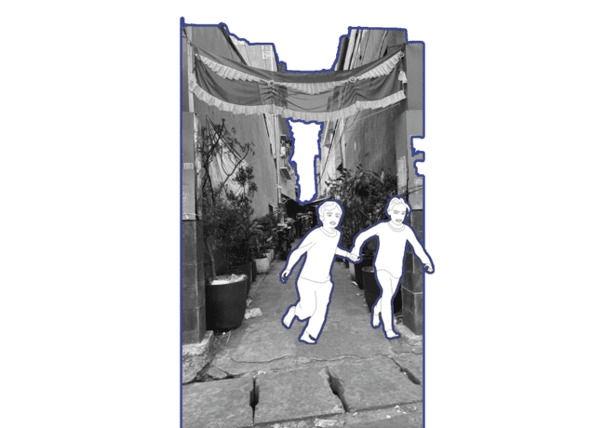
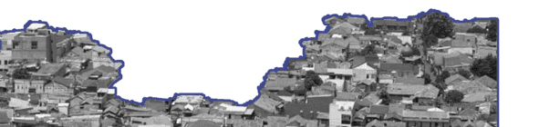

Jalur Air Sosial: A Design Toolkit for Flood-Resilient Kampung Alleys
Interactive Urban Flood Micro-Intervention for Kampung Context
Hack4Resillient Jakarta 2025
Gang Up Team
INSERT LOGO WEBSITE ATAU TEAM

Slide 2
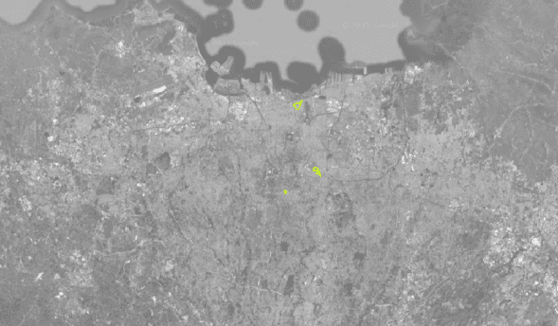

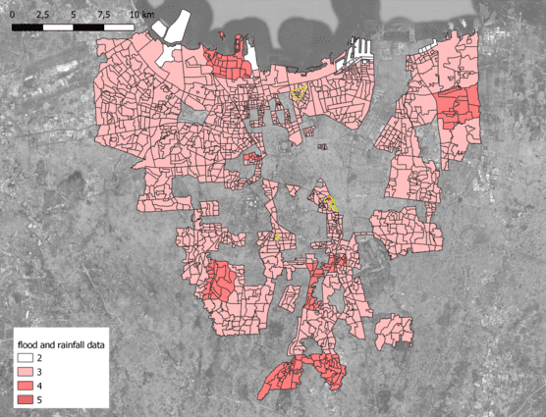
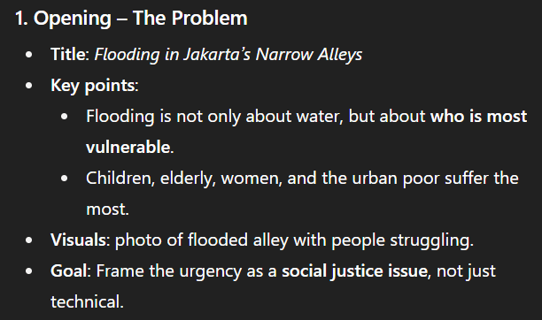
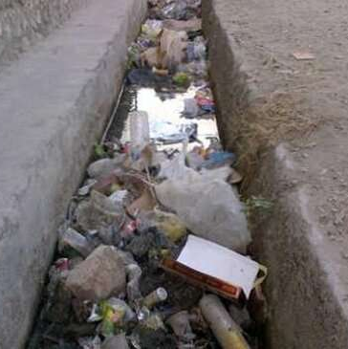
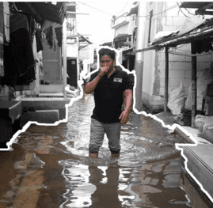
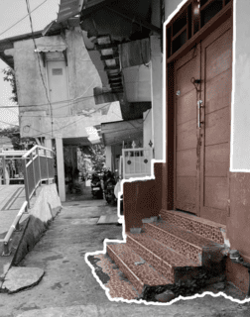
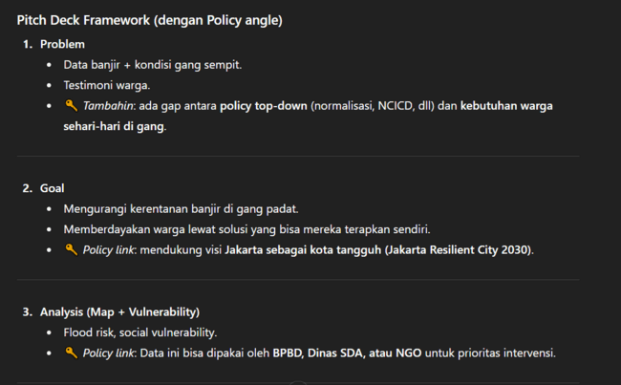

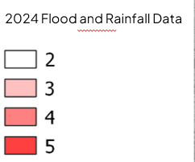
Large-scale flood projects don’t solve these micro-scale problems.
This weakens community resilience: disrupting livelihoods, health, and social life.
There is a need for localized, community-based interventions to build resilience.
Issue and Problem Statement
Flooding in Jakarta’s Narrow Alleys
Poor drainage and impermeable concrete surfaces worsen local flooding.
Clogged Drainage [2]
Jakarta’s dense kampung neighborhoods are highly vulnerable to recurring floods.
Narrow alleys (gang-gang sempit) dominate kampung circulation:
Frequently become unintended flood pathwaysAt the same time, serve as essential social and economic spaces.
Flooding is worsened by poor micro-drainage and impermeable alley surfaces.
Large-scale flood projects (embankments, floodways) show limited local impact in kampung areas (Farid et al. [1], Kampung Melayu).
As a result, residents are left with costly, unsustainable coping strategies such as raising floors or makeshift barriers.
This undermines community resilience: recurring floods disrupt livelihoods, strain social cohesion, and reduce quality of life.
The gap highlights an urgent need for localized, community-based interventions that strengthen both flood resilience and neighborhood development.
Jakarta’s kampung neighborhoods face recurring floods every year.
Gang Flooding [3]
Residents cope by raising house floors, which is costly and unsustainable.
Narrow alleys known as Gang, often turn into flood paths but are also critical social spaces.
ung
2024 Flood and Rainfall Data
[1]
Raised House Floors in Pela Mampang
[1] Shabrina, Z., Muharram, F. W., Dhirgantara Putra, D., Rui, J., & Asa, M. (2025). Hack4Resilient Jakarta 2025: Sinking City [Data set]. Zenodo. https://doi.org/10.5281/zenodo.16836145
.
[2] https://kupang.tribunnews.com/2017/07/02/tersumbat-sampah-drainase-di-jalan-pemuda-matawai-waingapu-tak-berfungsi
[3] https://www.tempo.co/arsip/-muara-angke-jadi-langganan-banjir-rob-dki-jakarta-843532

Slide 3
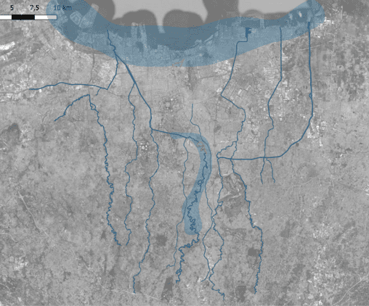
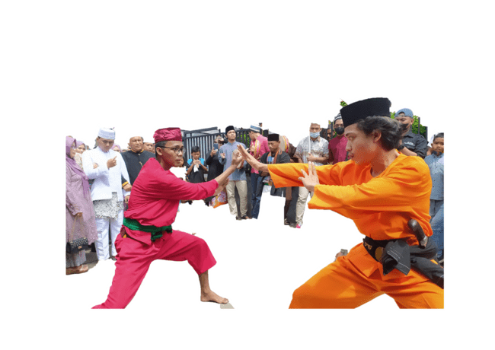
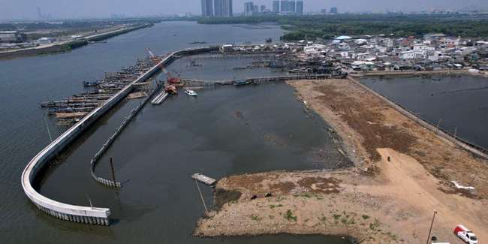

Jakarta’s kampung neighborhoods face recurring floods every year.
Narrow alleys often turn into flood paths but are also critical social spaces.
Poor drainage and impermeable concrete surfaces worsen local flooding.
Residents cope by raising house floors, which is costly and unsustainable.
Issue and Problem Statement
Flooding in Jakarta’s Narrow Alleys
Large-scale flood projects don’t solve these micro-scale problems.
This weakens community resilience: disrupting livelihoods, health, and social life.
There is a need for localized, community-based interventions to build resilience.
Tidal Flooding
Jakarta’s dense kampung neighborhoods are highly vulnerable to recurring floods.
Narrow alleys (gang-gang sempit) dominate kampung circulation:
Frequently become unintended flood pathwaysAt the same time, serve as essential social and economic spaces.
Flooding is worsened by poor micro-drainage and impermeable alley surfaces.
Large-scale flood projects (embankments, floodways) show limited local impact in kampung areas (Farid et al. [1], Kampung Melayu).
As a result, residents are left with costly, unsustainable coping strategies such as raising floors or makeshift barriers.
This undermines community resilience: recurring floods disrupt livelihoods, strain social cohesion, and reduce quality of life.
The gap highlights an urgent need for localized, community-based interventions that strengthen both flood resilience and neighborhood development.
Flooding is multi-dimensional, with different types and complex underlying causes.
This weakens community resilience: disrupting livelihoods, health, and social life.
River Flooding
[3]
Large-scale flood projects does not always solve micro-scale problems such as flooding in alleys (gang). [2]
There is a need for localized, community-based interventions to build resilience.
ung
2024 Flood and Rainfall Data
Pluvial Flooding
[1]
[1] Shabrina, Z., Muharram, F. W., Dhirgantara Putra, D., Rui, J., & Asa, M. (2025). Hack4Resilient Jakarta 2025: Sinking City [Data set]. Zenodo. https://doi.org/10.5281/zenodo.16836145
.
[2] Farid, Mohammad, et al. “Study on Effectiveness of Flood Control Based on Risk Level: Case Study of Kampung Melayu Village and Bukit Duri Village.” MATEC Web of Conferences, vol. 101, 2017, p. 05003, www.matec-conferences.org/articles/matecconf/pdf/2017/15/matecconf_sicest2017_05003.pdf, https://doi.org/10.1051/matecconf/201710105003. Accessed 4 Jan. 2022.
[3] https://www.senibudayabetawi.com/6576/tak-hanya-setu-babakan-inilah-tiga-kampung-betawi.html

Slide 4

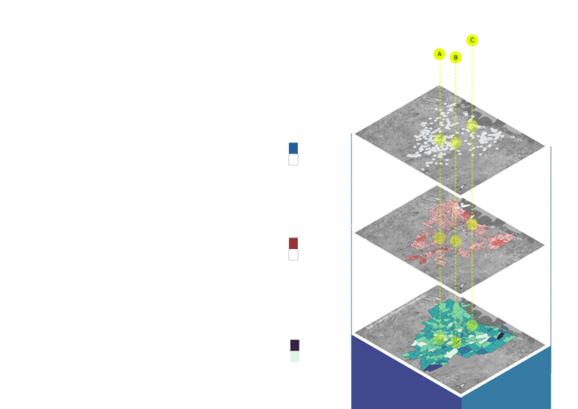
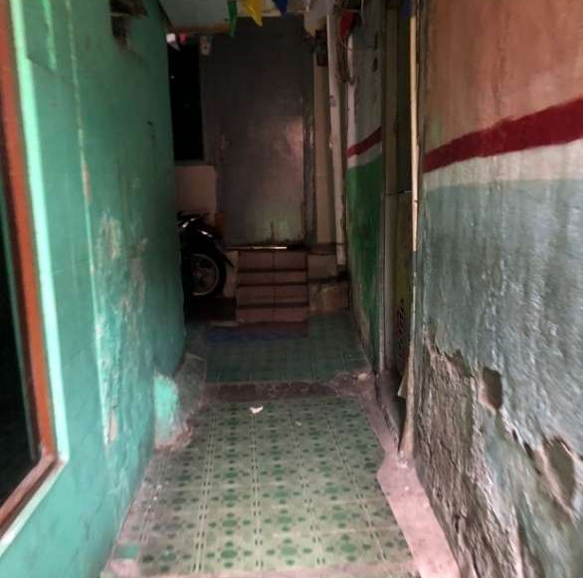
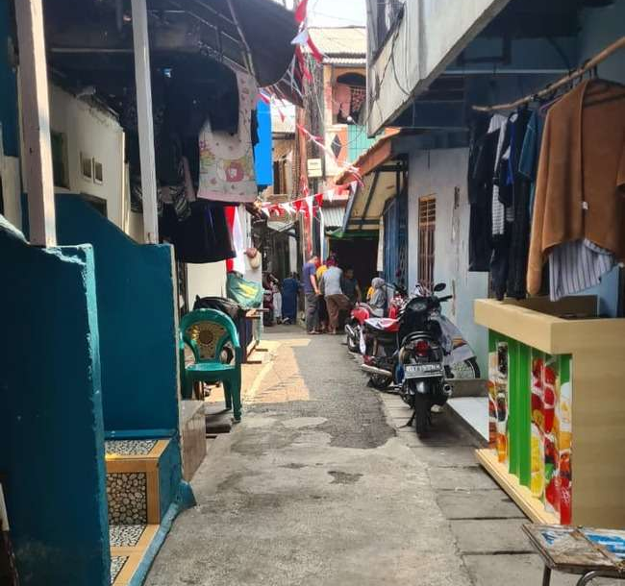
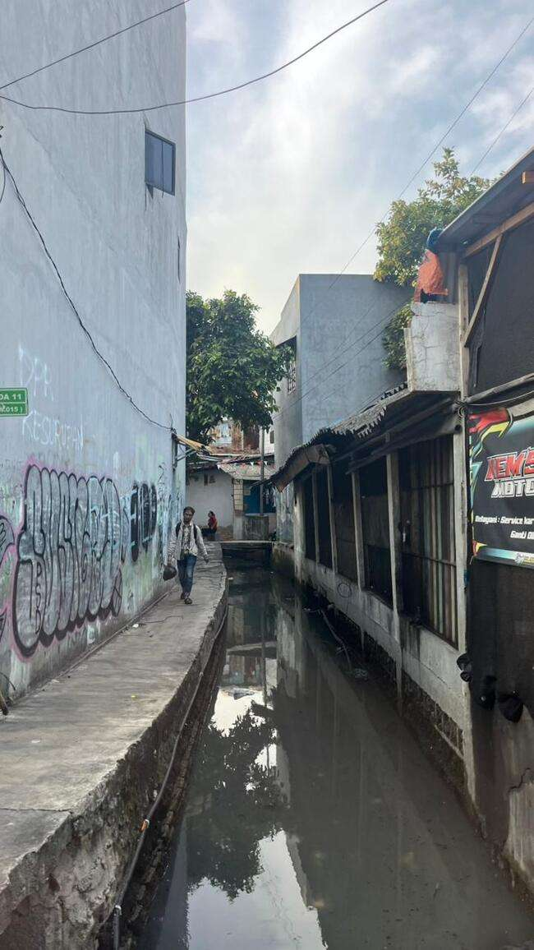
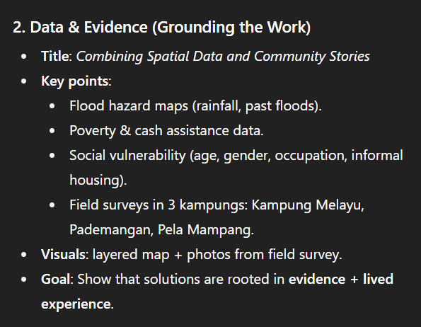
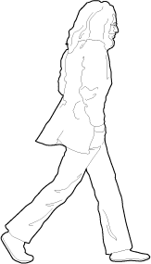
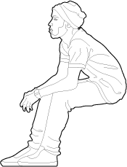
Evidence and Data
Combining Spatial Data and Community Stories
A
B
C
Pela Mampang
Kampung Melayu
West Pademangan
“If possible, the road should just be paved with asphalt so it looks better.” -Head of Household at Kampung Melayu
Age Score (1-5), Gender Score (1-5), Poverty Score (1-5), Education Score (1-5) = Total (4-20)
“The kampungs that get flooded badly are the ones down below, since it’s downhill. Here, our kampung is higher.” – Pela Mampang Warung Clerk
This reflects how many residents still prioritize visible improvements such as paved roads, rather than flood-adaptive infrastructure. It shows a gap in awareness about how surface treatments like asphalt can actually worsen water absorption and flood risk.

Slide 5
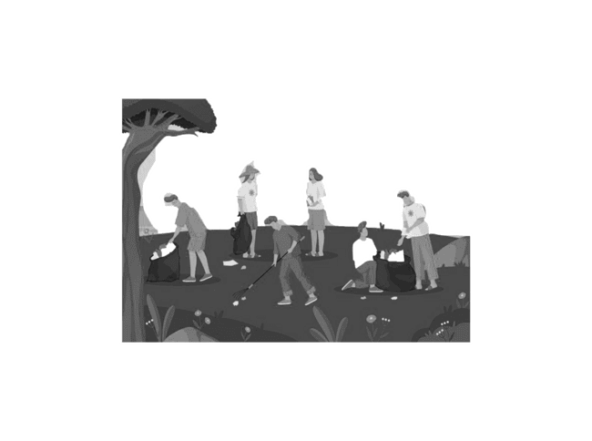
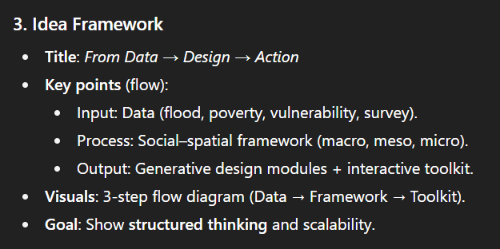
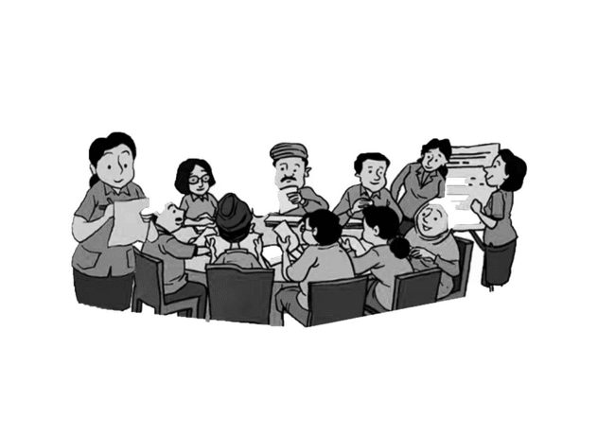

Objective
Goals and Idea Framework
Connect
Create
Commit
Bridge communities and various stakeholders through solutions grounded in evidence and lived experience.
Deliver adaptable design guidelines with cost estimation for diverse flood-risk typologies across Jakarta.
Strengthen kampungs by centering community voices in design and decisions.
Engagement
Co-Creation
Refinement
Implementation
Participatory Design
Understanding
Design Toolkit
Guided by the website (BedahGang)

Slide 6





Methodology
Who are the Users?
Community Empowerment Programme
Corporate Social Responsibility (CSR)
Private Companies
Non-Profit Organizations
Each user has a role in sustaining flood-resilient kampungs.
Community
From residents who live in the kampung, to local leaders, NGOs, and private sectors, our toolkit is designed to be usable and adaptable by all stakeholders.
University Community Service Program (KKN)
Participatory Planning Forum (MusRenBang)
RT/RW Leaders
University Students

Slide 7
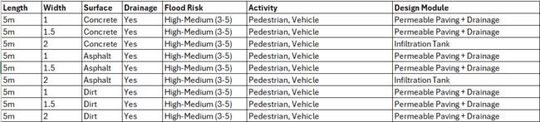
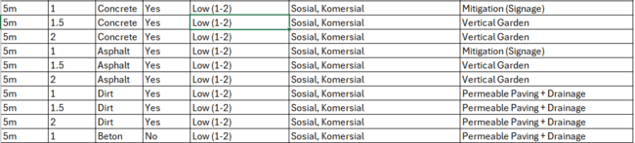
Methodology
Project Workflow
PROBLEM 1
Narrow kampung alleys often become flooded, but lack effective micro-drainage infrastructure.
PROBLEM 2
Community-based flood adaptation strategies are underutilized and hard to replicate or access by citizens and local leaders (RT/RW)
Design Matrix
DATASET 1: FLOOD RISK
Flood Frequency, BPBD Flood Depth, Topography, Drainage Systems , Rivers
DATASET 2: URBAN MORPHOLOGY & BUILT ENVIROMENT
Informal Buildings, Cadmapper for Visualization
DATASET 3: SOCIO-DEMOGRAPHIC VULNURABILITY
Population Density, Education Level, Poverty Level, Age, Gender, Cash Assistance
METHODOLOGY 1
Spatial RIsk Mapping & Typology Classification
METHODOLOGY 2
Visual Site Interpretation & Human-Scale Documentation
METHODOLOGY 3
Design Toolkit Development & Digital Interface
Design Matrix
EXPECTED OUTPUT 1
Typology Map of Kampung Melayu, Pela Mampang and West Pademangan
EXPECTED OUTPUT 2
Modular Alley Design Strategies
EXPECTED OUTPUT 3
Interactive Website (Demo Version)
Made into a 5 m2 module for Cost Estimation Feature on the website
Data to input on the website
Output Design Solution

Slide 8
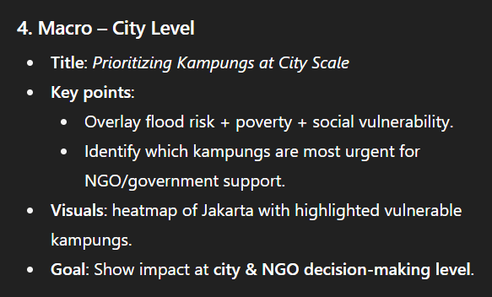
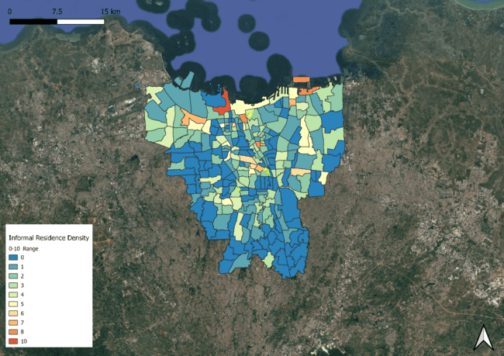
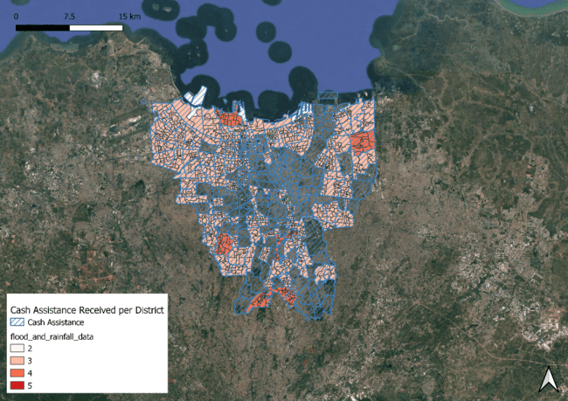
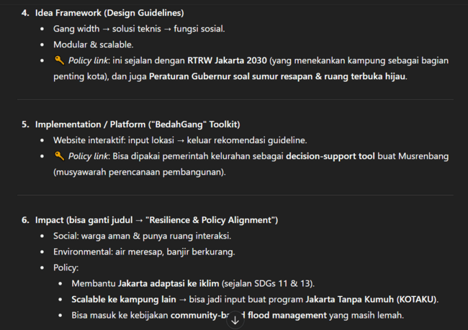
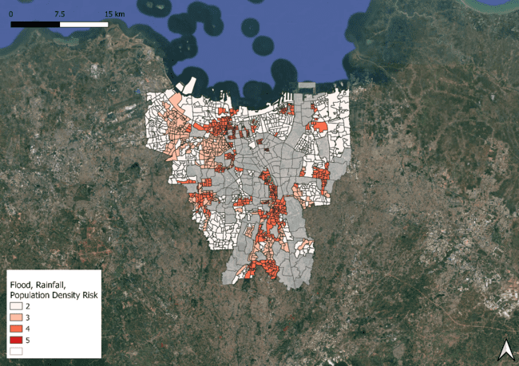


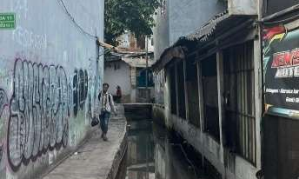
Macro Analysis
Prioritizing Kampungs at City Scale
C
C
A
B
B
A
Informal Residence Map
Cash Assistance, Flood and Rainfall
This data is linked to website as Flood Risk Indicator
B
C
A
C
B
Pela Mampang
Kampung Melayu
West Pademangan
A
This analysis examines three kampungs with distinct characteristics and challenges, highlighting patterns of informal settlements, flood exposure, population density, and social vulnerability to guide intervention priorities.
Flood, Rainfall, Population Density Risk

Slide 9
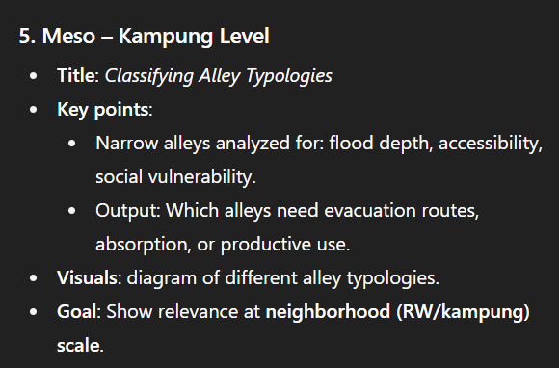
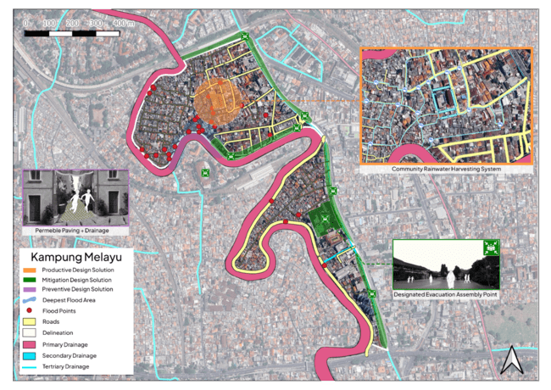
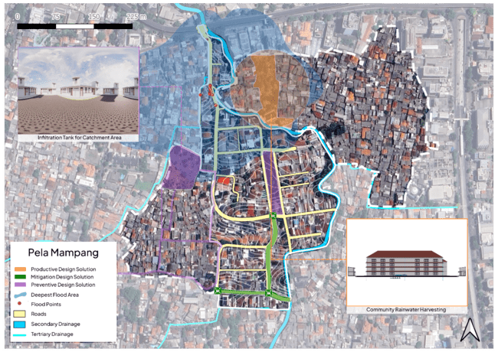
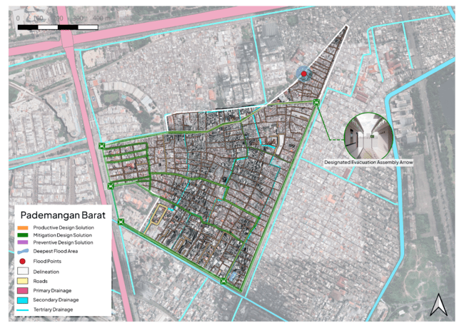
Meso Analysis
Meso-Scale Vulnerability & Opportunity Mapping
Kampung Melayu
Pela Mampang
West Pademangan
Near the River, Medium Depth of Flood, Yearly Flooding
Formal housing between 2 dense Kampungs, very deep flooding in the north
Low flood depth, Flood source mainly from Tidal Flooding
Viewing meso-scale maps across three kampungs helps reveal different constraints and risk patterns. This broader perspective guides the development of context-sensitive micro-scale design solutions.

Slide 10
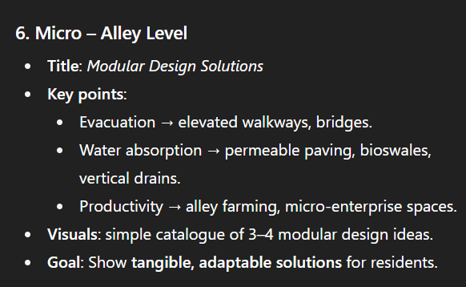
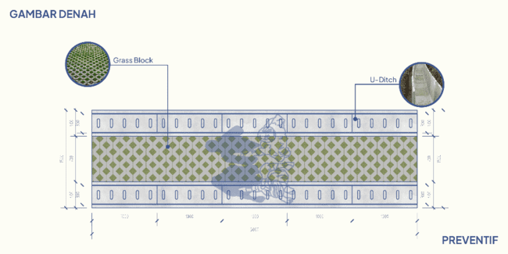
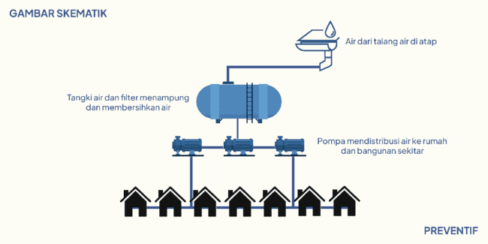
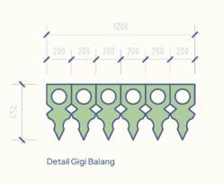
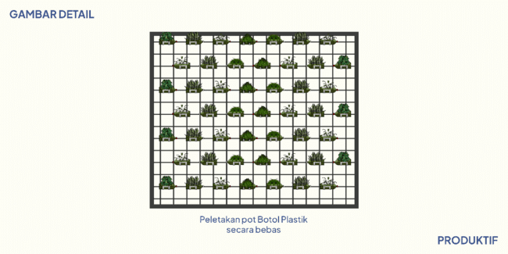
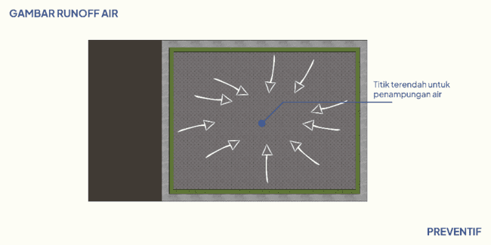
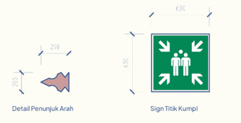
Micro Analysis
Alley Design Solutions
Through the meso-level analysis of the three kampungs, we identified five key design solutions. To make them more structured, these solutions are classified into three categories: Mitigation Solutions, Preventive Solutions, and Productive Solutions. Importantly, these solutions are not fixed; they are designed to be adaptive and can be further developed or expanded over time in response to changing needs and contexts.
Mitigation Solutions
Preventive Solutions
Productive Solution
Signage and Assembly Points
Permeable Paving
Community Rainwater Harvesting
Infiltration Tank in Catchment Area
Vertical Garden

Slide 11
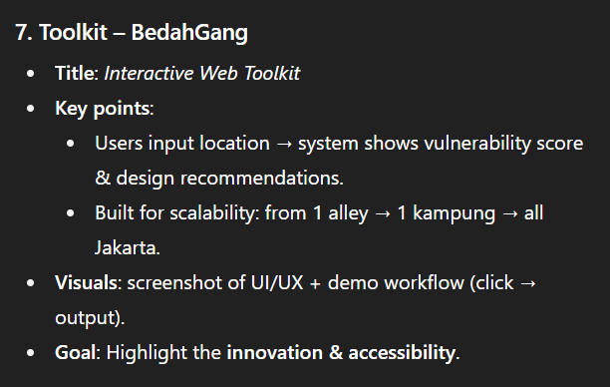
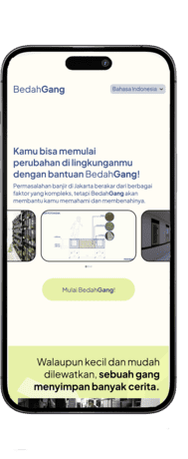
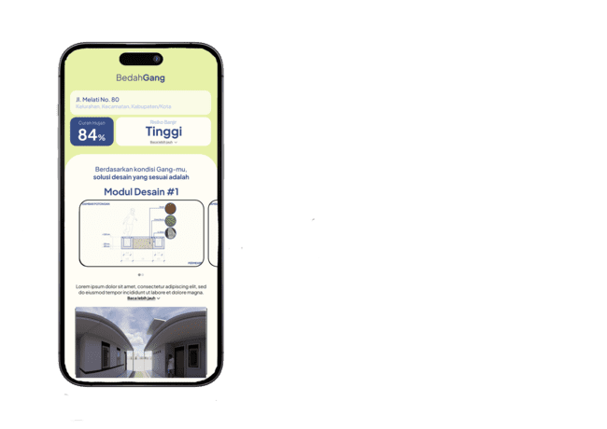
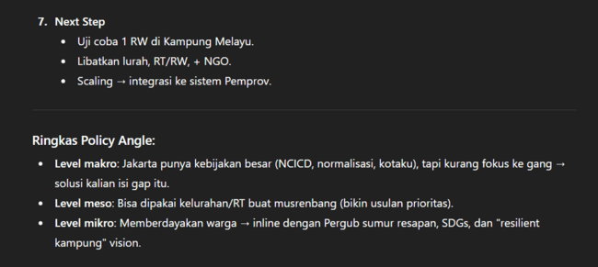
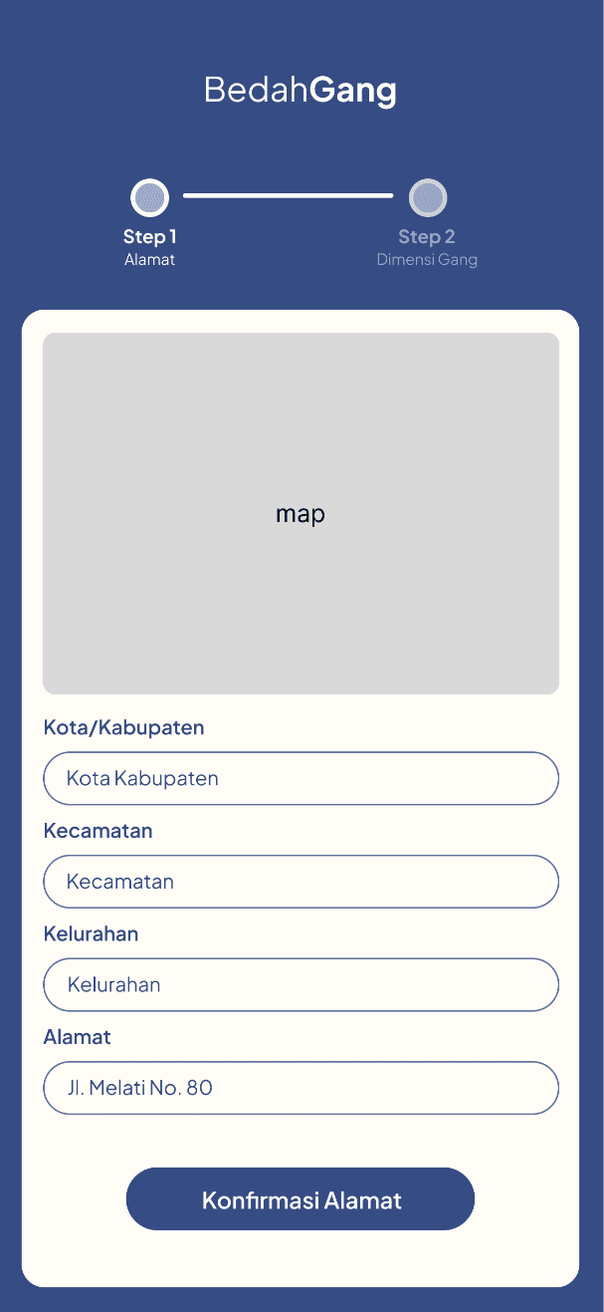
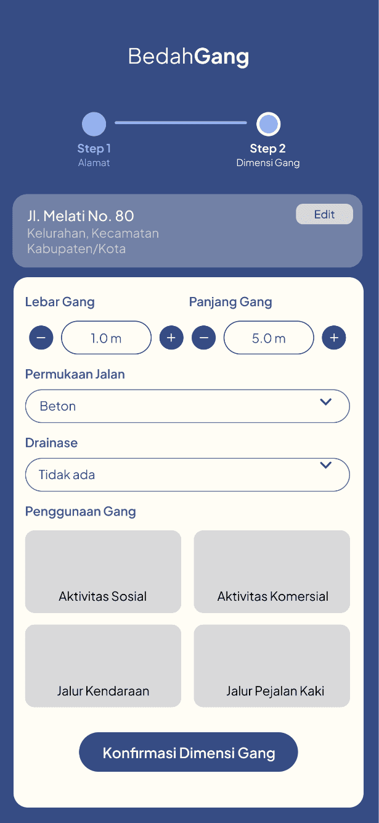
Demo
Interactive Web Tool kit
About the BedahGang
The platform bridges communities and various stakeholders by providing evidence-based, adaptable design guidelines for diverse flood-risk typologies, while centering community voices in decision-making.
Data to Input
Location
Dimension
Surface
Drainase
Activity

Slide 12
Scalability Plan
What’s Next?
Connect
Create
Commit
Engagement
Co-Creation
Refinement
Implementation
Understanding
Design Toolkit
User Activity Sharing
Currently guided by BedahGang
RAB-based rough cost estimation that highlights monetary value
Participatory Design
Scale and Replicate
Enhance Drainage Data Features
Pairing with Augmented Reality (AR)
AI Generated Design Matrix
Desktop Website
BedahGang Scalability Plan

Slide 13
Beyond floods, towards resilience
Jalur Air Sosial opens pathways not only for water, but for people to live and grow together.

